Slide 1

Netcare + Real-Time
AI-Driven Emergency Response & Network Intelligence Platform
Team Name : CodeNova

Slide 2
CONTENT
01
Problem Statement & Target Audience
02
Our Innovative Solution
03
Technical Stack & Architecture
04
Feasibility & Key Challenges
05
Unique Selling Point & Business Model
06
Team Members

Slide 3


01
PROBLEM STATEMENT & TARGET AUDIENCE
Problem Statement
Emergency healthcare in India faces three major gaps:
Emergency response is slow because patient data, location, and doctor availability are not in one place.
Poor network quality disrupts telemedicine and coordination.
No real-time dashboard → delays in treatment and decision-making.
Primary: Hospitals, doctors, ambulance services.
Secondary: Patients, rural areas, emergency operators.
Beneficiaries: Critical/emergency cases needing fast response.
Target Audience

Slide 4
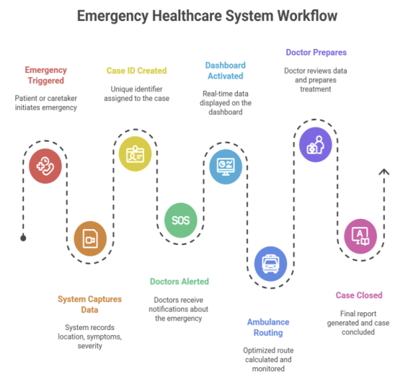
02
OUR INNOVATIVE SOLUTION
Instant Emergency Intelligence
Instant case creation with patient details, symptoms & live location.
Smart risk scoring + unique Case ID generation.
Real-time doctor alerts & case acceptance.
Unified dashboard replacing fragmented systems.
Live Network & Communication Engine
4G/5G network quality analyzer for stable telemedicine.
Tower strength, latency & stability monitoring.
Predictive connectivity checks during emergencies.
Ensures uninterrupted doctor–patient communication.
Real-Time Routing & Hospital Coordination
Optimized ambulance route through dynamic maps.
Live ambulance tracking + patient vitals + status updates.
Doctor portal for notes, treatment updates & case timeline.
Complete operational view of hospital & doctors.

Slide 5
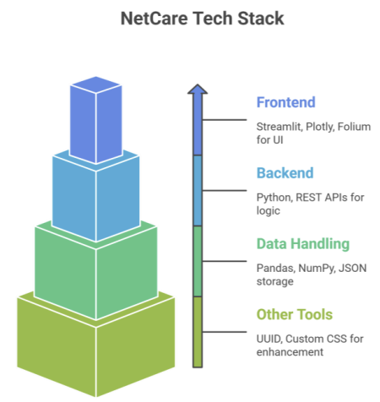
03
TECH STACK + ARCHITECTURE
Tech Stack
Architecture
Frontend
Streamlit (UI)
Plotly (interactive charts)
Folium (live maps)
Backend
Python (core engine)
REST APIs (network + location + case updates)
Data Handling
Pandas, NumPy (real-time data processing)
JSON (lightweight storage)
Additional Tools
UUID (secure case IDs)
Custom CSS (modern healthcare UI)
1. Emergency Input Layer
Captures patient details, symptoms, live location
Generates unique Case ID
Assigns priority/severity
2. Processing & Intelligence Layer
Real-time case management
Network quality analysis
Smart routing + continuous updates
3. Doctor & Hospital Interaction Layer
Doctors accept/decline cases
View vitals, add notes, track progress
Live communication + updates
4. Visualization & Dashboard Layer
Maps, heatmaps, ambulance tracking
Timelines, status panels, availability
Complete operational real-time view

Slide 6

04
FEASIBILITY & KEY CHALLENGES
Feasibility
Uses lightweight Python backend → easy to deploy.
Real-time APIs make live data integration practical.
Scalable for hospitals, ambulances & telemedicine setups.
Works on existing 4G/5G networks (no special hardware).
Key Challenges
Network Variability
Real-time 4G/5G quality differs across locations, affecting telemedicine and live updates.
GPS Inaccuracy
Live tracking and optimized routing depend on accurate GPS data.
Data Integration
Combining hospital, ambulance, and network data in real time is complex.
User Adoption
Doctors, nurses, and ambulance staff require training to use the system smoothly.

Slide 7
05
UNIQUE SELLING POINT & BUSINESS MODEL
• First emergency system combining healthcare + real-time network analytics
• Dynamic network heatmaps for telemedicine quality
• End-to-end case lifecycle in one interface
• Low-cost, high-impact prototype deployable on hospitals
• Works on real-time data streams, not static forms
USP (Unique Selling Point)

Slide 8
B2B Subscription – Hospitals pay monthly/annual fees.
Ambulance Integration Fee – Charge per ambulance added.
API Partnerships – Revenue from telemedicine & govt integrations.
Premium Add-Ons – AI triage, ETA prediction, advanced analytics.
Customization Services – Hospital-specific dashboards & modules.
Maintenance & Support – Annual support and service fees.
Business Model

Slide 9
06
TEAM MEMBERS
Member 1
Member 2
Member 3
Member 4
VIKAS SINGH:
Full Stack Development and
System Architecture
DRASHANT TOMAR:
Backend & API Integration
ASTHA PATHANIA:
Frontend & UI/UX Design
UPASNA PATEL:
Project Strategy & Networking

Slide 10
THANK YOU

